Slide 1
The Battle of the Neighbourhoods
CLUSTERING AND IDENTIFYING CHARACTERISTICS OF AN AREA FOR PRODUCT PLACEMENT IN INSTALLED VENDING MACHINES

Slide 2
Issue
A vending machine company wants to improve sales by identifying what products would sell better in a particular area in London. Our analysis will target the problem by categorizing the different types of business areas. Since vending machines are automated retail miniature stores that offers product line flexibility we will analyse different clusters according to their characteristics to conclude the type of products that could be placed.
London has a lot of business potential for automated vending machine. Since london has a lot of activity, movement of people and transportation there is quite the need for quick service. London is a truly international city which is complimented with a fantastic mix of cultures and nationalities. Having accomplished that London is a great place for business, choosing the right business premises in London is imperative to stimulate sustained business growth as the cost of renting in London is higher compared to other cities.

Slide 3
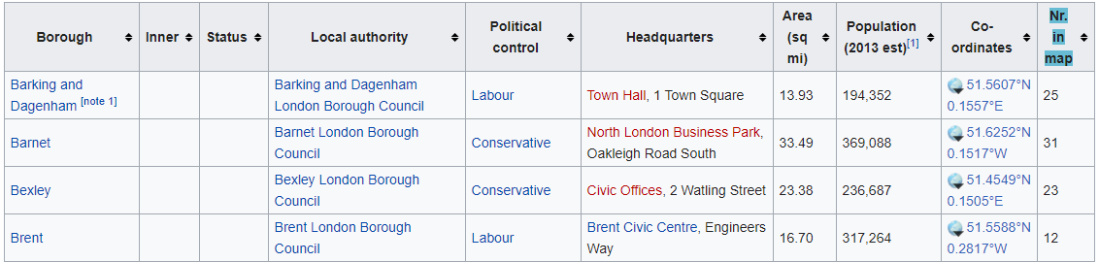
Data
In this project shere are two different data sets
1) List of London Boroughs where the machines would be installed
source: Wikipedia
url: https://en.wikipedia.org/wiki/List_of_London_boroughs

Slide 4
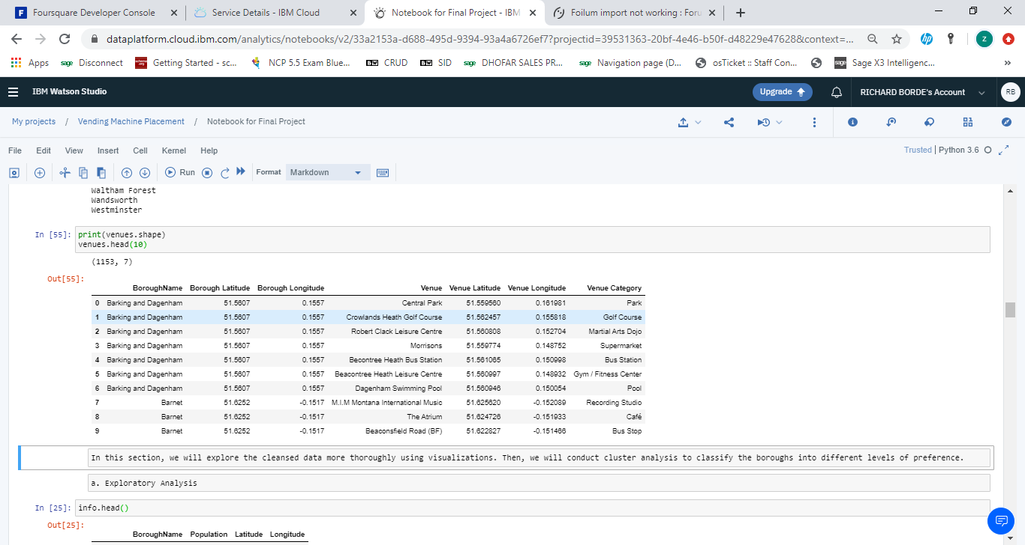
Data
In this project shere are two different data sets
2) Foursquare API
List of top 50 popular places in the neighborhood
source: Foursquare
url: https://api.foursquare.com

Slide 5
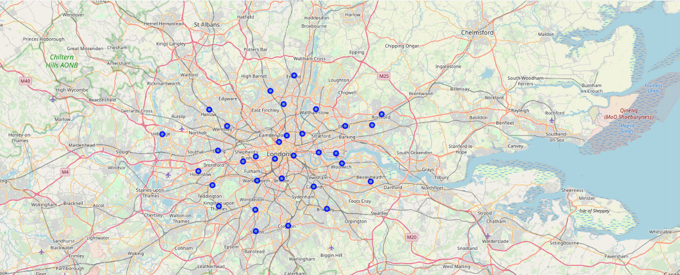
Methodology 1 Exploratory Analysis: Map of London
Plotted Coordinates of each borough to visualize them on the map

Slide 6
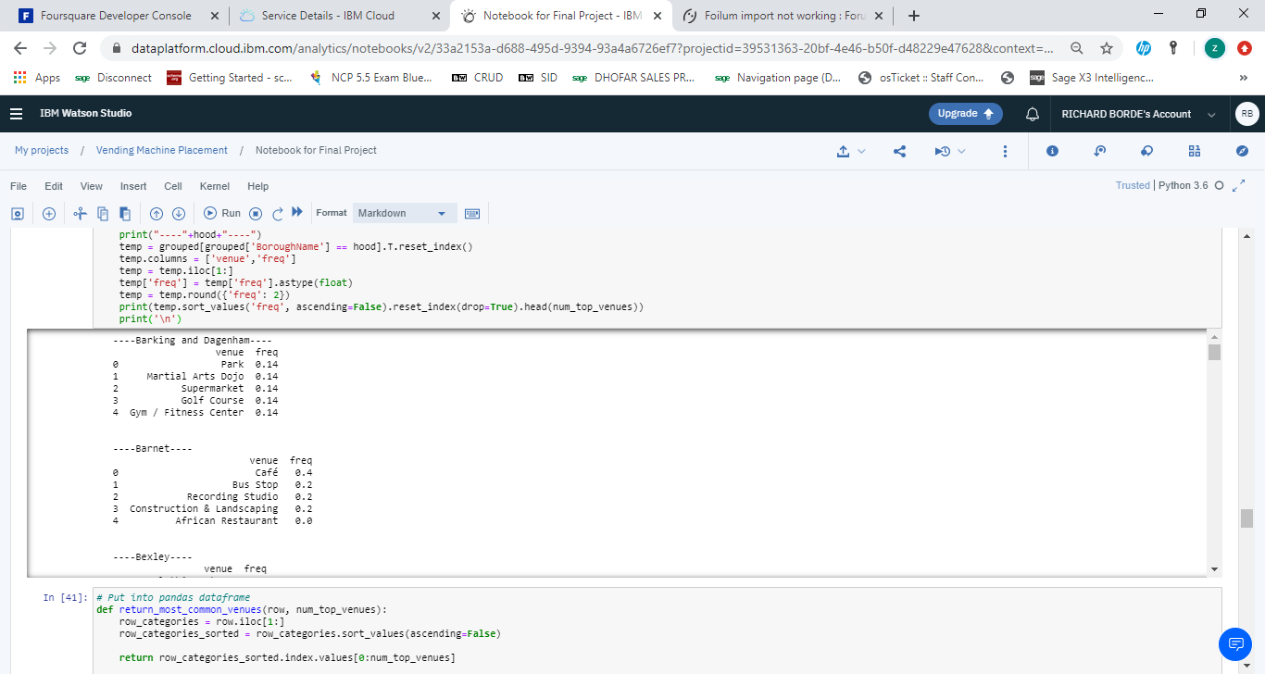
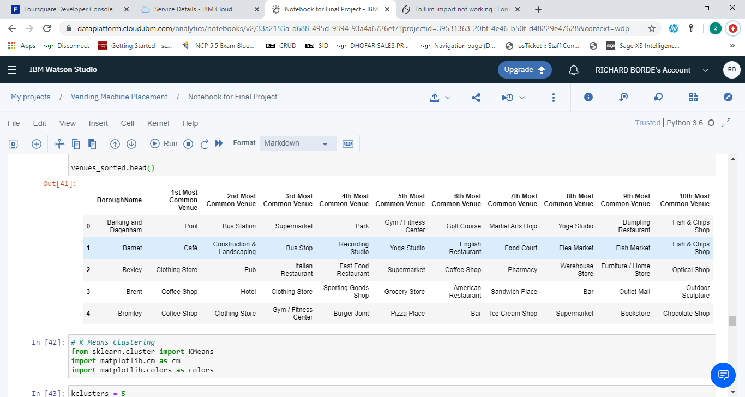
Methodology 2 Cluster Analysis: Popular Venues
Used one hot encoding to find the most popular venue categories from top 50 venues acquired from Foursquare. Grouped by borough names while frequency identifies popularity of the venue

Slide 7
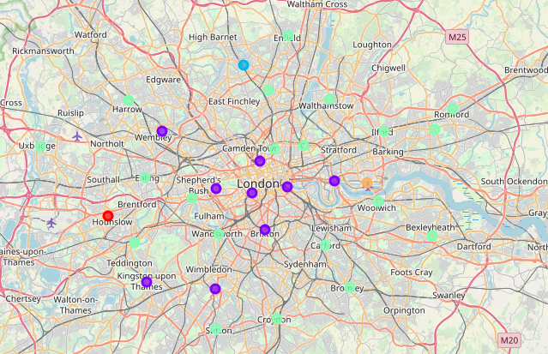
Methodology 3 Cluster Analysis: K-Means Clustering
Based on common venue categories, boroughs were grouped into five clusters as displayed

Slide 8
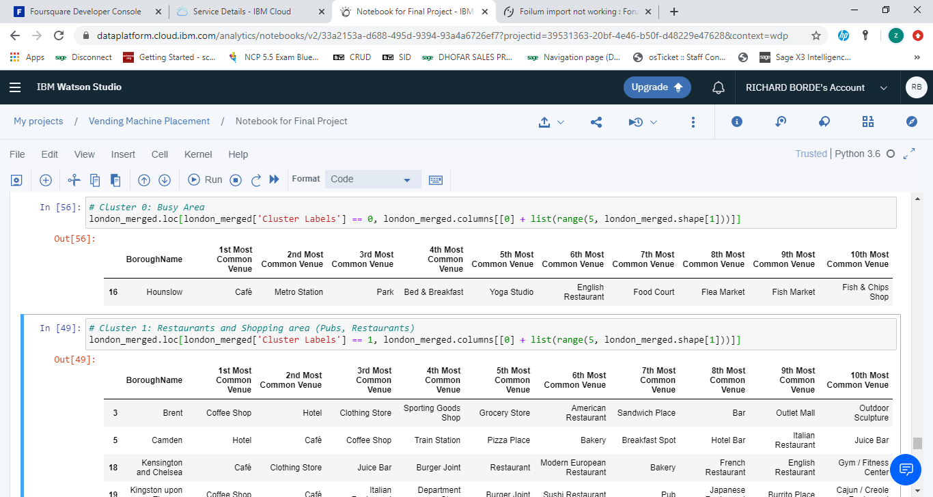
Methodology 3 Cluster Analysis: K-Means Clustering
Each cluster was then given a name according to the characteristics they displayed

Slide 9
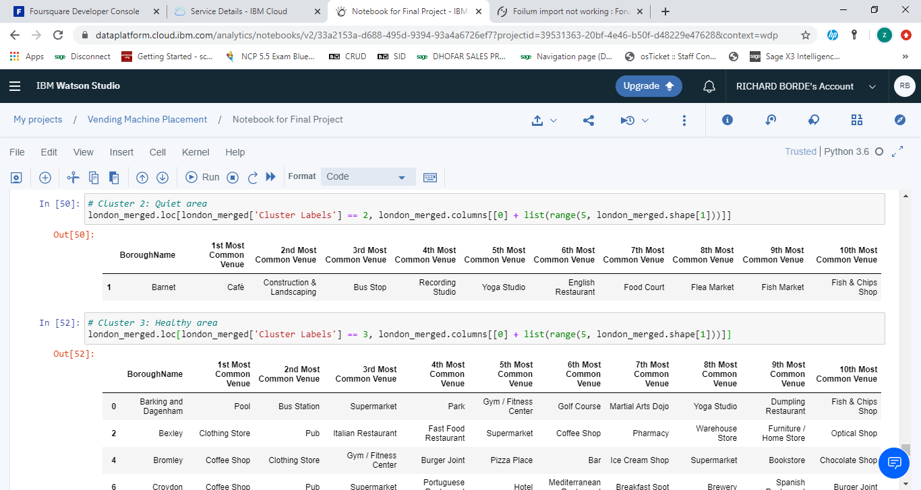
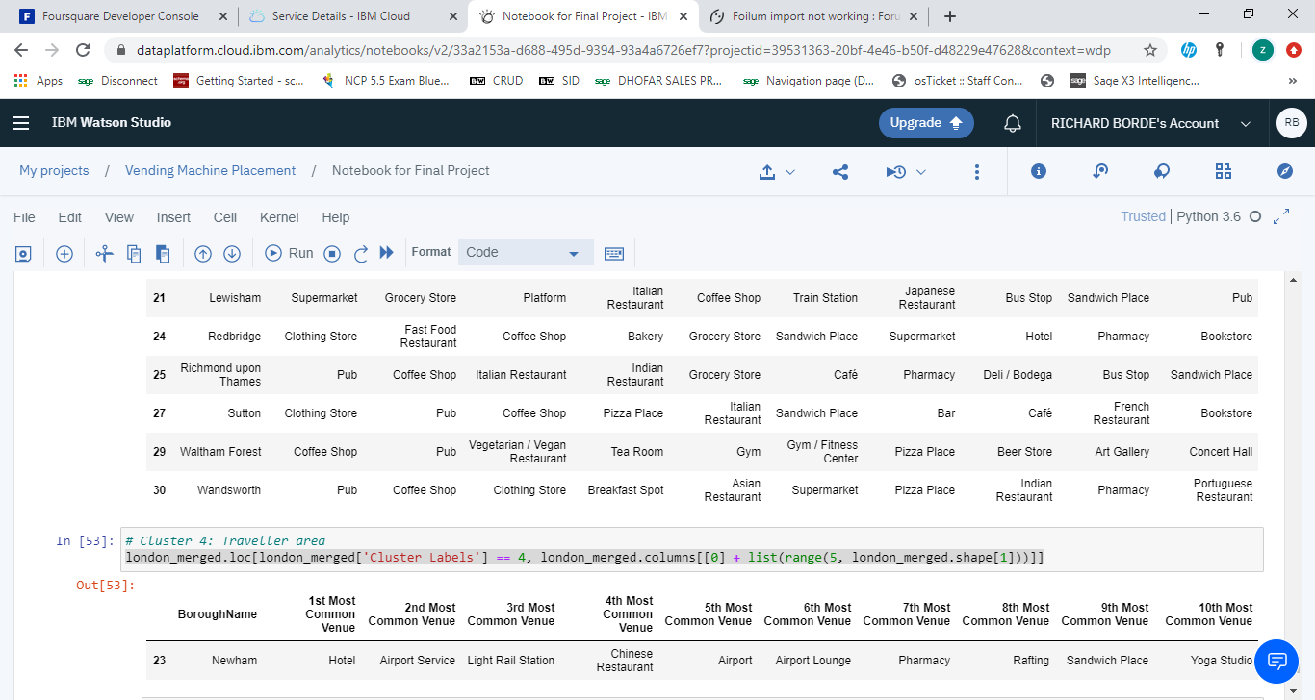
Methodology 3 Cluster Analysis: K-Means Clustering
Each cluster was then given a name according to the characteristics they displayed

Slide 10
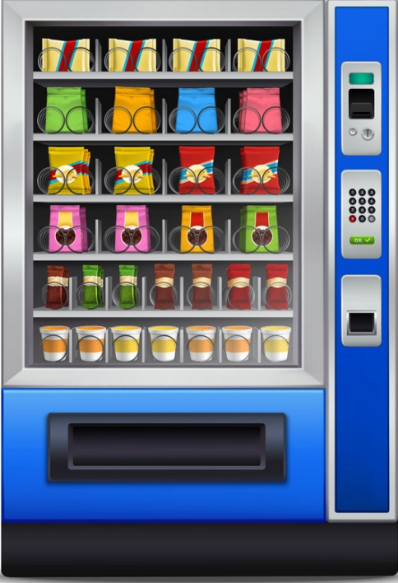
Result
As identified we have made clusters based on characteristics and will now be in a better position to identify the products to be placed in the vending machines in those areas.
Stocking the vending machines in the Healthy area with disposable wet wipes, water bottles, gum etc would may yield more sales and profits.

Slide 11
Conclusion
Limitations
However, it obviously seems strange that the best places to install vending machines in London are all far out suburbs. This is due to limitations this research holds. Among numerous factors that determine a good neighborhood, we only took into consideration what type of venues are popular for the sake of simplification.
To overcome the limitations of this study, we will need further data such as population concentration and sqft. rental prices. Nevertheless, this research was still meaningful in that we were able to explore the neighborhoods in depth.

